Slide 1
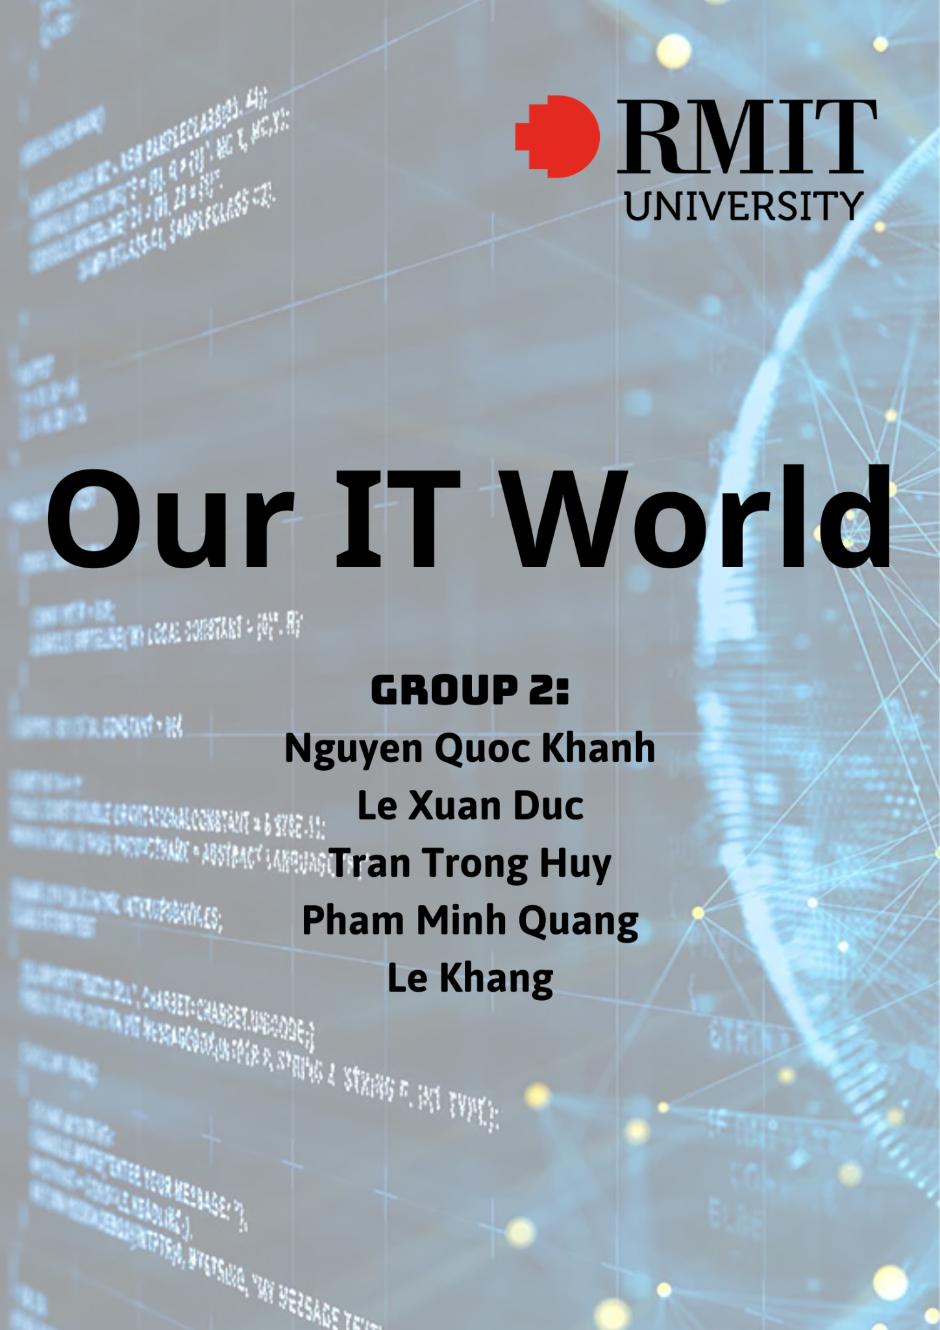

Slide 2
Table of Content
Team Profile
Overview
Aims
Plan and Progress
Roles
Scope and Limits
Tools and Technologies
Testing
Risks
Group Processes and Communication

Slide 3
Team Profile
Group (NoIdea.Inc)
Phạm Minh Quang (s3978814):
I am Pham Minh Quang, the technical supporter of the team, my job is helping all other members when there are some technical issues, such as a bug in codes or some problems in arrangements, double check slides and script quality,..... When I’m free, I enjoy spending my time playing games, reading books with some music on for the vibe. I have very little experience in IT but I can see my improvements afters days studying. In the future, I want to be a backend developers, or jobs that require working with new ideas and innovative experiences. After spending weeks together, working on this project, I think there’s still lots of flaws in group work., the procrastination of people. However, we managed to finish it to an extent and I think we would keep developing it in our free time.
Lê Xuân Đức (s3975039):
Hey there, I am very new to IT. Loves playing games and researching about PC components. My future career is looking forward to work in a tech company. I have experience so much things during this course in RMIT along with my group members. I am the project manager for the group, in charge of making and edit report assignments for the group. So far, I am getting along well with my group member compare to the first day. In the next semester we hope to stick together and do a lot more amazing projects so that we gain more experience of team working and support skills for future jobs.

Slide 4
Trần Trọng Huy (s3979815):
I’m the developer of the team. My job is to help adding more function for the bot. This is not a difficult project to work on, but it is a good stepping stone for my future projects. Through this project, I made new friends as well as got used to working in groups. Before this semester, I’m still new to IT and RMIT, but these teammates helped me to get on well with the environment and studying method here. When we have free time, we usually hang out or play games together. Hope that this team will stick together in the next semester.
Nguyễn Quốc Khánh (s3916278):
Hello, I'm the project's head manager. This is because I am the only person of my group that has expertise in programming a product similar to the theme of this project. As a result, I was in charge of overall project management and development. Despite the fact that I claim to have experience, I am still a beginner in this sector. Because I am aware that technology has been and will continue to be an important subject in the future, I have persisted on my IT adventure. I will not stop working until I reach my objective of constructing my own empire.
Lê Khang (s):
I’m the host meeting. My job is to make a schedule for our group meeting either online or offline. And also after getting to know each others, I can see the strengths and weakness in each member of our group. Therefore, I in charge of assigning works for the group members and making schedule so we can meet to work on our project. The project is really fun and I was really enjoying it. Still, I’m new to IT so I have a lot to learn and experience. After the project, I’m looking forward to study more about IT and making new friends and conquer all my future goals in RMIT and life.

Slide 5


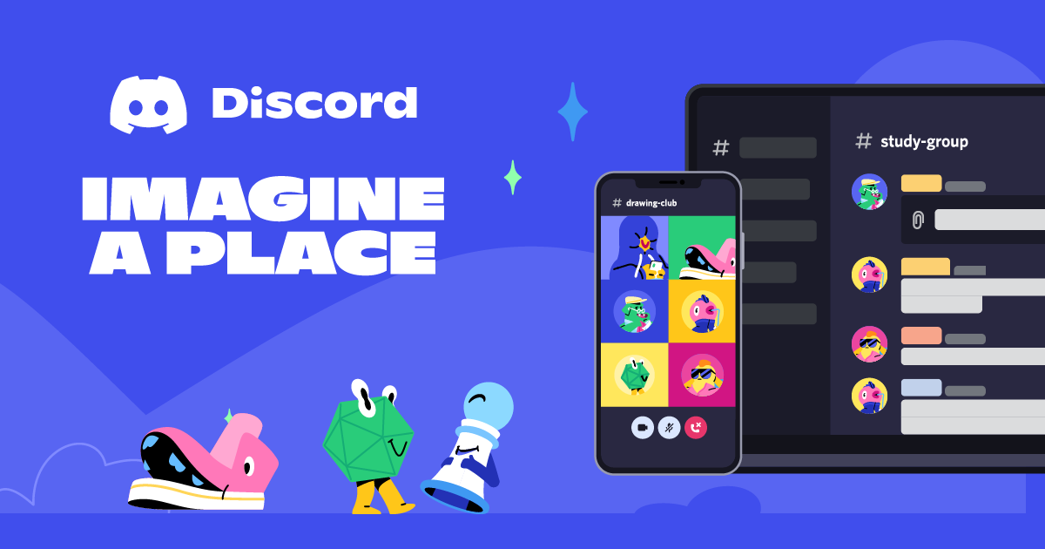
Overview
Our project is about creating a discord bot. We wanted to make our own bot because most of the popular bots are lack of features that we need. By making this bot not only we manage to make discord more entertaining, we also have opportunities to study more about coding to improve our bot in the future. Our bot will have most of existing features of other popular bots and we will add our own features.

Slide 6

Overview
The Motivation
The already existing Discord Bots are great and have their own uniques and convenient features. However, we feel like there’s some missing things. Since Discord is a place where I and my my friends usually hang around, chit chatting, playing games together and sometimes even movie night. Thus, we want to make it a special place that able to brings our own colors to it.
The convenience it can brings us is really something worth spending time on developing. However, what truly motivates us to start this project is the will to try new things and what we can learn from this. It may help us be more familiar with modules in Python and gain some programming experiences.

Slide 7

Aims
Personal Use:
As we mentioned earlier, we want to create a bot because of its convenience and uniqueness. We want to make it easy to use and adjust (just for the us) the bot.
Popularity:
The bot was originally developed for us-the members in the group to use in our Discord server only. However, after witnessing its potential, we decided to make public so people can use it too. Thus, everyone can experience the fun while using it.
We expect our bot will run smoothly while it is operating in discord servers. We want our bot to become popular, especially for students so it will not just for casual users or gamers, it will support students for their future studies.

Slide 8
Plan and Progress
Time | Quang | Đức |  | Khánh |  | Huy |  | Khang
1st | Forming group Get contact each other A group call to talk over the idea of each teammate for the topic
2nd | Creating and making the proposal | Researching and writing Take part in editing and finishing the proposal
Submit the proposal
3rd | Studying about how the Discord bots function Get to know the basic of coding using Python (discord module) Grouping up to start discussing about how to make it work like what we expected
4th | Explain the tasks and give them to team members. Support Khánh in bot development |  | Start developing. Self-study in order to add some other features in the future |  | Start developing. Spend time trying some popular bot on Discord. |  | Support Quang to explain and giving tasks to team members
5th | Spending time discussing about features to add in. |  | Finish some of the simplest features of the bot |  | Help Khanh with adding features for the bot. |  | Suggest and showing the variety of discord bot features to add in our bot
6th | Quite confused about what to do because the bot doesn’t work like we expected | The bot seems malfunctioning at first so we tried to fix it. | Ran into some problems while developing. |  | Still try to find more functions for the bot. |  | Help Quang and Khanh solve the problems while making the bot

Slide 9
7th | Meeting. Problems solved. We fixed the code. However, adding Rank System in is quite difficult. |  | Try to fix the problems, some of them are fixed, but some are not. I’ve tried to put the Rank System, but this feature is not necessary | Adding function and fixing bugs. | Start to make schedule for our meeting working on the discord bot
8th | Study for the tests but still spend some time to look in the projects so that we don’t forget what to do
9th | Continue developing with Khánh. Learn and taking notes while making so that I can make 1 myself in the future | Make projects reports and presentation. Gather group members to give their reflections | Developing with Quang, fixing some problems found. | Testing to make sure that the bot do well. | Help Huy on making reports and presentation, giving reflection
10th | Leave the bot to Khánh. Help members prepare for the presentation. Make a github website. | Edit and make some changes for the IT world report. | Adding some customize feature to the bot, make sure the bot running properly and stay online 24/7 | Helping Khanh for the final product. | Start working on the Skills and jobs report
11th | Finish everything and start assemble the report. Double check if there’s anything that need adjustments. | Make sure everyone finish their own reflection then submit the report. | Make sure everything working fine, present the bot to the group. Start to demonstrate the bot to members | Finish everything. Final check before the presentation. | Finish everything and go through the report again for double checking then submit.

Slide 10
Scope Expected features of the Discord Bot
Rank System
We really want to create some sense of competition in the server and also encourage everyone to participate in server activities so this is a good idea to add in.
Certain action like getting lots of reactions, beating a person in a game or contribute to the server, …… will be noticed and get ranked up
Higher ranks offer members the ability to change certain things in a server, a better role and access to the high rank chat
Music
Adding music in is really important since everyone would use it to create a vibe in the conversation.
Lots of existing bots take music via Spotify instead of Youtube and that quite annoys us because there’re many masterpieces on Youtube that Spotify never add in.
Games (activities for member and some may require a certain rank)
Tic-tac-toe
Connecting Words
Calculating Contest
Memes
The bot will take random memes on the Internet and send it to chat
There will be some categories for the memes so that everyone get to see the topics they likes
Notification
This would really be a big help since announcing some events in the notification channel and give members roles is some annoying works that we don’t really want to do ourselves.

Slide 11
Scope and Limits
When we working on this project, we have some scope and limits such as:
Some scope:
Responding to server orders and messages
Automating duties such as server moderating or poll creation to provide information or resources to members
Some limitation:
The bot can only communicate with the server and its members; it cannot communicate with other servers or external websites.
The bot can only carry out actions that are permitted by the Discord API and the server's permissions.
The bot's capabilities are restricted by the developer's programming skills and resources.

Slide 12


Tools and Technologies
In this project, we use replit as a platform to code because it’s online so it would be easier to share between the team.
In terms of the coding language, we use JavaScript instead of Python because our head developer said that there were more resource that support JavaScript than other languages.
Discord and Messenger are the 2 main ways for us to communicate and sometimes even Teams because of the convenience and all of us have accounts on these social media.

Slide 13

Testing
The bot works really well, there are lots of unexpected command like drake and god call which makes it really fun to use. Other discord bot that plays music often keep playing even when there’s no one left in the voice chat, but our bot would automatically exit when the voice chat is empty. Another notable feature is that Khánh our head developer design it to be a very cute bot with adorable lines.
We will stress test our bot by making it run multiple commands on differents server to see if it is running properly. If there is any bugs we will immediately fix the bot. Our group member will be the first testers, then we will ask small servers to test our bot and so on. We expect to have a few attentions from larger communities to use our bot.

Slide 14

Risks
Teamwork
It would take a lot of time to start working properly since we don’t really know each other very well and have little experience in a project like this.
Although we have made some rules for the group, members may not follow it because of some private reasons.
Too many ideas but no decisions
Some members may not be serious when the project come, resulting in extra work for the ones who really worried about grades and achievements in class.
Time management
Everyone have their own schedule so sometimes it requires more time to finish a given task
Some members don’t really follow the timetable and stuck in a load of work.
This is not the only project we are currently working on and there’s also the tests that we have to prepare for.
Solution
Create a shared calendar on Teams so that we can know if there’s anybody busy on the meeting day and reschedule it or take some notes for the absent member to have a grasp of it
Make some punishments for the members that are late or not finish the task on time

Slide 15

Communication
Our group members communicate with each other mainly through a group chat online. If there is an important meeting then we will meet face-to-face at a place such as the library at campus.
We also create some rules in our group to make sure everything is working properly:
Have an online meeting every weekend
Always ask for opinions before deciding some important changes in the project
Be on time (most important)
Be nice and friendly to other members
As a member, everyone must participate in building the project and finish the assigned task. If there’s any problem, a member can always contact others for help and we will get a solution.
Every file relating to the project will be shared to all members via Google Drive. Some specific ones must include comments to describe the progress in order to make everyone understand.

Slide 16
Skills and Jobs
Our project is about Discord Bot, a helpful tool for Discord servers that does a lot of things. This is the strategy I'll use to create the project if funding is available:
Boost the bot's quality; it is still in the middle of development and has not yet reached perfection.
Put the bot on a virtual private server so that it can operate continuously.
To advertise the bot, set up a public server, a website, pages on social media sites, and upload the bot to bot.gg.
Just make a portion of the bot's features available.
Increase the appeal of the bot by giving it new features and regular updates.
Release a premium edition with the complete experience for a modest monthly cost after the product reaches a certain level of popularity.
For this approach to produce the desired results, I would need some staff. We would first need a trustworthy leader because I am not very skilled at managing and leading. Everything was quite disorganized as a result. Thus, the project would be more effective if it had a new, better leader. If necessary, the leader would also assist other team members in various areas
.Required skills: Management, accountability, open communication, and organization.
In addition, I've come up with a ton of features that we can test adding in, such as the mid-developed Rank System, a money management supporter, meme generators, etc., so it's crucial to add two more devs. It took a lot of work to update the bot on a monthly basis, but I think two updates will do for now. We will require more in the future if the project is successful.
Required skills: JavaScript, HTML, Open to new concepts, ideas and able to quickly apply them.
Another important member of the team is the designer. Their efforts would mostly center on improving the website's presentation, creating a welcoming and simple user experience there, managing the pages, the navigation bar, etc.
Required skills: HTML, CSS, knowledge of databases and how they work on websites
Last but not least, the final component for a complete team is an advertiser who will manage sites, write posts, run the server, and the community we developed. As a result of our interactions with the community, we are also able to swiftly supply the required update in the monthly update by getting feedback and comments on new concepts, bugs, and improvements.
Required skills: Communication, Writing skills, Community management, Polite.

Slide 17
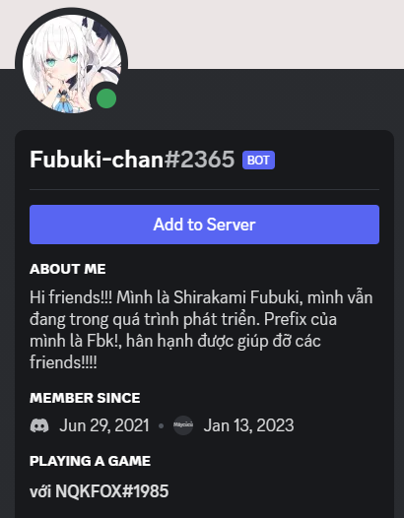
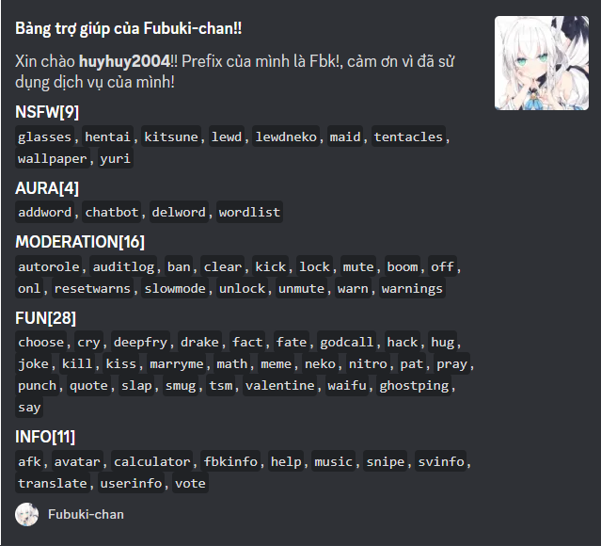
Project Outcomes
Our bot: Fubuki-chan
Functions:
When you use the help command on the Discord server (every command must begin with Fbk! ), you will see a list of the available commands. utilizing the standard music and moderation commands.
There are also some entertaining
commands to experiment with.
Although some are still being
developed, the ones that have
already been released are
incredibly great.
These features can make your Discord experience more enjoyable. It has been put to the test on our servers, and some of our friends have also tried it. Positive comments have been made, and it is promising.
But there are still many issues, the bot isn't finished, and it's still in the middle of development. Hosting, a number of instructions that don't function as intended, and thousands of flaws that sometimes take more time to fix than the software itself to code.
We may need a long time to complete it, but we'll do our very best. Debugging, planning, developing a system to work more effectively, and making it distinct from other bots that are already on the market. This may enable us to distinguish our bots from those of others while demonstrating a fresh, original approach to Discord bot development.

Slide 18
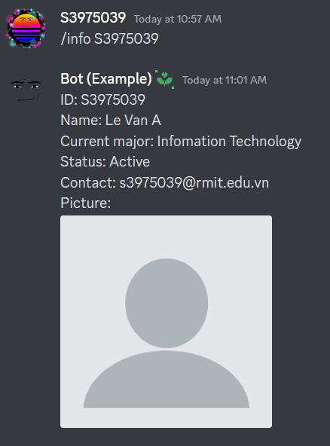
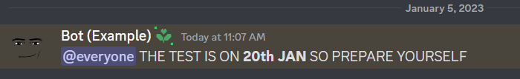
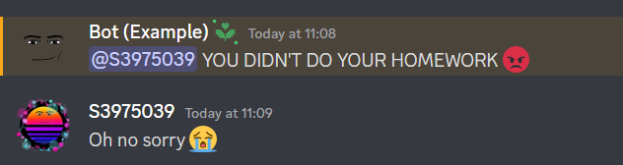
Our unique features for the bot
Give information about other students using one single commands
Announcement on important events
Reminds student when they did something wrong

Slide 19
Group Reflection
Lê Xuân Đức:
Since this is my first year of studying in the university. I was a bit worried about not making any friends there. Fortunately, this IT course gave me an opportunity to make friends by forming a group. My group has 5 people and all of that was my first time I meet them. It was a bit awkward to talk to them at first but when there was a team project that we need to do, we always meet each other and did the project on time before the deadline. The thing that surprise me the most about my group is that we have a lot of things in common which is why we can get along very fast. I have learned so many thing from my group in this course, especially the way we manage our timetable is truly efficient and suitable for every group member. I think I would stick with this group so we can get to know more about each other.

Slide 20
Phạm Minh Quang:
After working together for 3 months, we might not be the most productive group, but we did our best to finish the project and had a lot of fun. At first, me and my friend – Khang was put in a group with 2 SGS students by mistake and we were really confused at that time because the deadline for Project Proposal is coming. However, I managed to ask for help and we joined this group. We quickly made friends with everyone else and got to work as soon as possible. Everything was really messy at the beginning since the members don’t really understand what to do. Because there was no time left so I did most of the work for the Project Proposal and I’m quite disappointed by the team. I didn’t think they would be this passive. The next day after submitting, I started convincing everyone to be more proactive and gave them roles in the team. Everything was going well after that, except for some small problems related to coding, bugs.
However, we managed to solve it perfectly. Weeks and weeks go by and it’s finally the end of the project, we may spend time to continue develop the bot because there’s still flaws and might not be able to compete with the available bots. After all, I have learned a lot from my team during the process but what I understood best was I better off work alone.

Slide 21
Trần Trọng Huy:
Starting college can be a daunting experience, especially making new friends. However, I was fortunate enough to find a group of 5 members through the Intro to IT course. Our group consists of five people, all of whom I had never met before. At first, we rarely communicate with others, but as we began working on a team project together, we quickly found our same hobbies. Not only did we manage to complete the project on time, but we also developed a strong bond as a group. I have learned a lot from my group members, particularly when it comes to managing our schedules effectively. Therefore, I am excited to continue working with them and getting to know them better.

Slide 22
Nguyễn Quốc Khánh:
Despite having some expertise creating Discord bots, I still allowed several bugs to surface during testing this time. Although it was mended in a timely manner, it still demonstrates the immaturity of my craftsmanship. This is my first year genuinely studying IT, and I have team members I can outsource tasks to so that I can focus on my own job. I'm hoping that we can stay together as a team in the coming semesters and continue to put on the finest shows.

Slide 23
Lê Khang:
Throughout the project, I have a chance to meet new people, making friends, working as a group but I also have some problems. Unfortunately , my friend Quang and I were placed in a group with two SGS students by mistake since we cannot form a group for our project, and we were very confused because the deadline for Project Proposal was approaching. Then, Quang and I managed to formed a group of 5 after Quang asked our lecturer for help. At first, it is quite hard for us to communicate so we are in a rush doing the project. However we did have a lot of fun and finished the project before the deadline. During the collaboration I learned how to work as a group and I also found what are my strengths and weaknesses. Although our group might not be the best in collaboration and most
efficient but we managed to overcome problems that we were facing at that time.
We have many things in common so it made the group work more effectively. And most importantly our project Discord bot was a success after spending weeks to code and solving problems. After the project, I learned a lot from my friend and also from another group and I still have lacked confident when standing in front of people so that's the weakness I want to improve. I'm looking forward to work with more people so I can learn more from them.

